Slide 1


The Wisconsin Housing CEA Program
Steven Deller
Todd Johnson
Karina Ward

Slide 2


The Wisconsin Housing CEA
Situation
Many of our communities are facing complex housing issues that require sufficient diagnosis of local and regional conditions as well as capacity to address them.
There are many different public agencies, private firms, non-profits, and public-private partnerships attempting to address housing issues using a variety of tools and processes.

Slide 3
The Wisconsin Housing CEA
What is UW-Extension’s Role?
UW-Extension Housing Research Group
A group of UW-Extension county-based educators and statewide specialists who:
Share research and investigate new ideas around housing;
Connect with public, private, and non-profit sectors to learn more about housing issues and opportunities; and
Develop and support housing curriculum used by local educators.

Slide 4
The Wisconsin Housing CEA
What is UW-Extension’s Role?
One Response
An educational program that helps communities identify their own local housing issues and their capacity to address them.
Collect (Data): Local Housing Snapshot
Organize (Assessment): Housing CEA
Select (Action): “Next Steps” Programming

Slide 5
The Wisconsin Housing CEA
The Wisconsin Housing CEA is modeled on the Extension Community Economic Analysis (CEA) program originally developed by Glen Pulver and Ron Shaffer in the 1980s.
The program was aimed at helping communities identify specific economic objectives and strategies that the community wished to pursue.
The CEA was conducted in several dozen communities throughout the 1980s and into the 1990s.

Slide 6
The Wisconsin Housing CEA
The original CEA was composed of three working sessions (90 minutes each):
  A discussion of economic data to better understand the strengths, and weaknesses, of the local economy.
  A discussion of economic development strategies to help communities better understand the range of approaches available to them.
  Development of specific goals/outcomes and strategies to be pursued to achieve those goals/outcomes.
  The county educator provided continuous follow-up work with the community over the next 16 to 24 months.

Slide 7
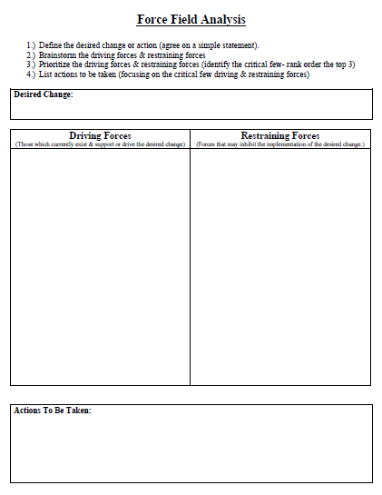
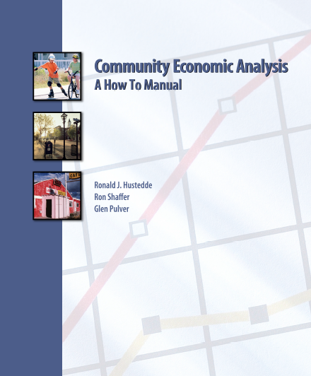

The Wisconsin Housing CEA
Some of the “classics” that came out of the original CEA...
Tools for data analysis.
Rethinking economic development strategies.
Force Field Analysis.

Slide 8
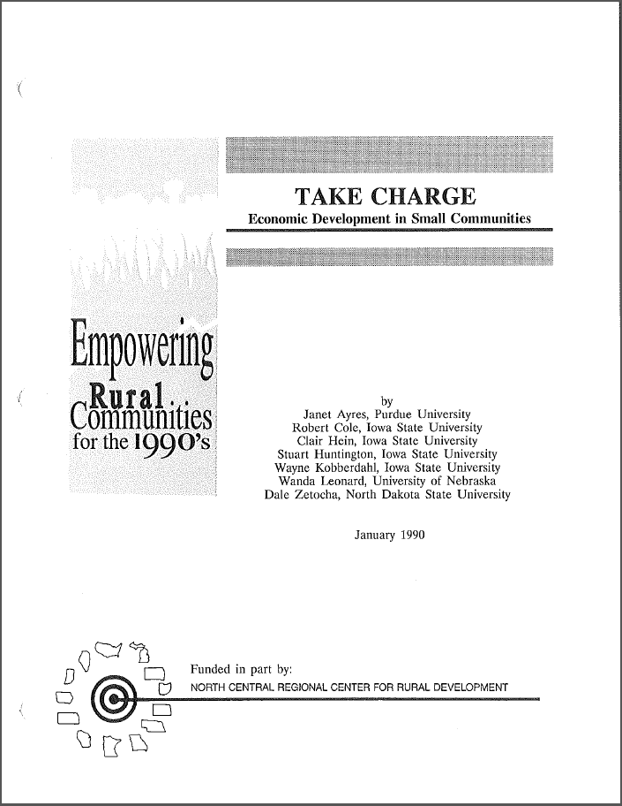

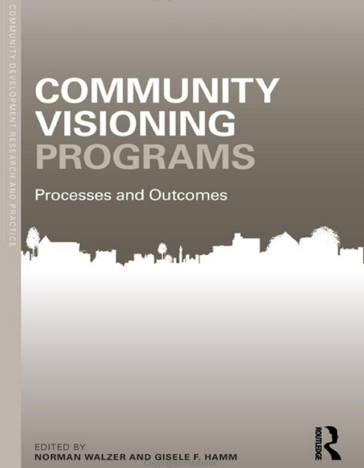
The Wisconsin Housing CEA

Slide 9
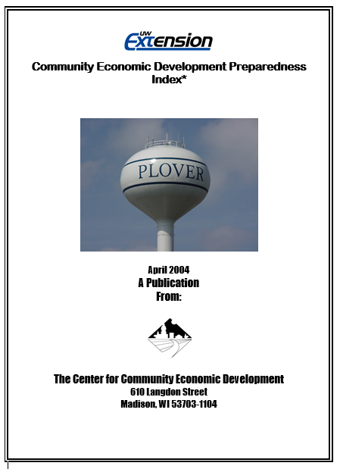
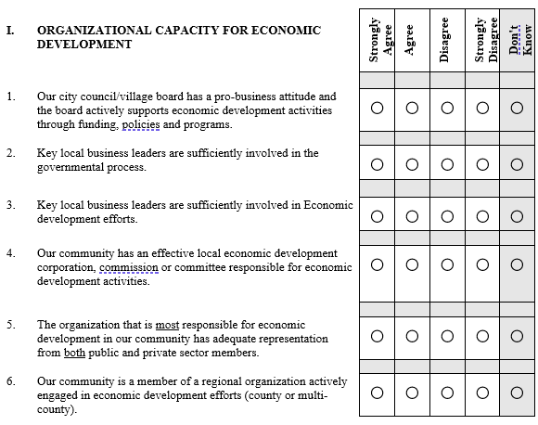
The Wisconsin Housing CEA

Slide 10
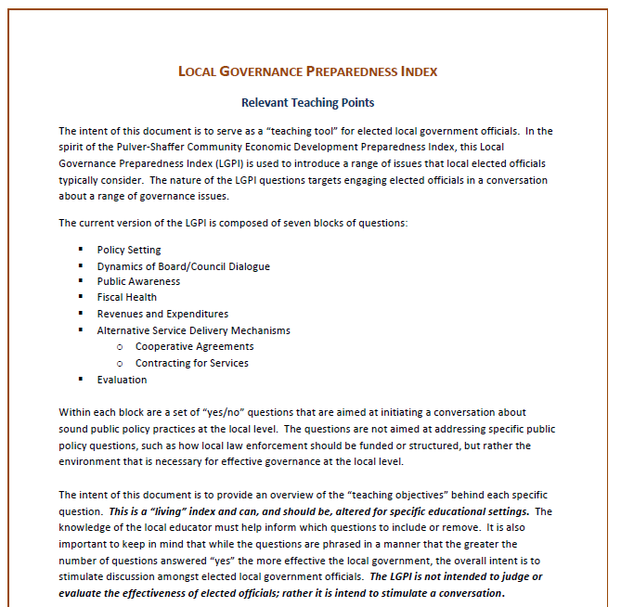
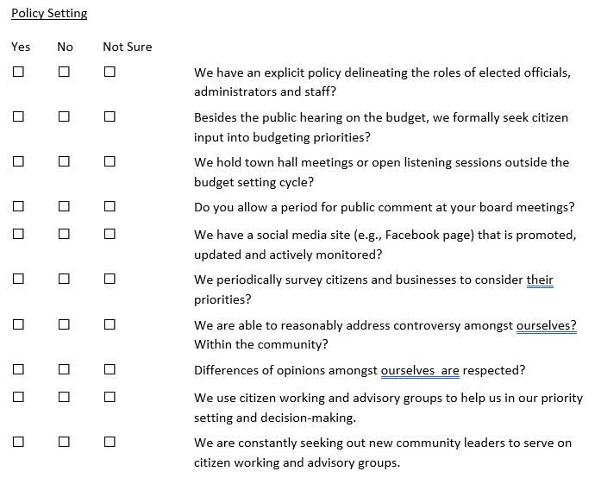
The Wisconsin Housing CEA

Slide 11
The Wisconsin Housing CEA
Is the community asking/talking about housing issues? Is a Housing CEA appropriate?
Identify 10-12 members of the community willing to devote time to the project (program).
First session: data overview, what does the data on housing tell us?
Second session: review strategies for housing (Housing Preparedness Index)
Third session: facilitate group discussion to identify 4 (+/-) actionable items for community to work on.
Provide follow-up support as the community moves forward.

Slide 12




Ozaukee County Housing Snapshot
Karina Ward
Community Development Educator
Ozaukee County Extension
University of Wisconsin-Madison
karina.ward@wisc.edu
Steven Deller
Department of Agricultural and Applied Economics
Center for Community and Economic Development
University of Wisconsin-Madison
Steven Deller
Center for Community and Economic Development
Department of Agricultural and Applied Economics
University of Wisconsin-Madison

Slide 13
Picture perfect “bubble”
Heading for another bubble?
Steven Deller
Center for Community and Economic Development
Department of Agricultural and Applied Economics
University of Wisconsin-Madison

Slide 18
Steven Deller
Center for Community and Economic Development
Department of Agricultural and Applied Economics
University of Wisconsin-Madison

Slide 33
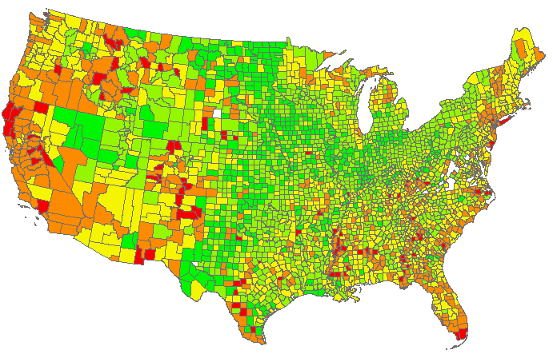

Housing Stress: Fiscal
How much house can you afford?
Use the 28-36 rule
Most mortgage lenders use the 28-36 rule to determine what you can afford and how much money they’re willing to lend you. The 28-36 rule states that your maximum household expenses shouldn’t exceed 28 percent of your gross monthly income.
If you earn $5,000 a month, that means your monthly house payment should be no more than $1,250.
Owner Occupied With Mortgage: 35%+ Income

Slide 34
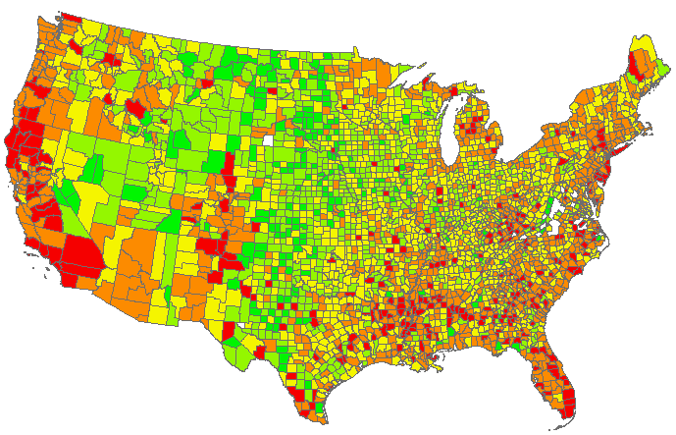
Housing Stress: Fiscal
How much house can you afford?
Use the 28-36 rule
Most mortgage lenders use the 28-36 rule to determine what you can afford and how much money they’re willing to lend you. The 28-36 rule states that your maximum household expenses shouldn’t exceed 28 percent of your gross monthly income.
If you earn $5,000 a month, that means your monthly house payment should be no more than $1,250.
Renter Occupied: 35%+ Income

Slide 35
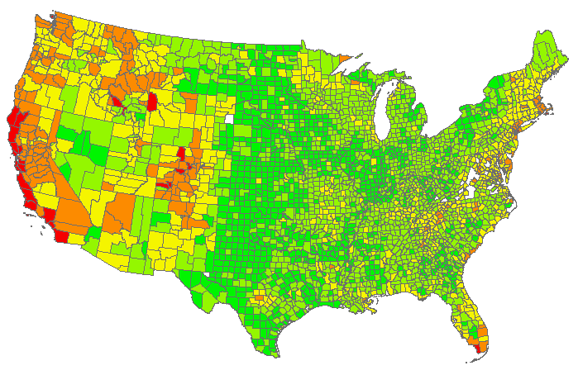
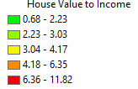
Housing Stress: Fiscal
How much house can you afford?
Use the 28-36 rule
Most mortgage lenders use the 28-36 rule to determine what you can afford and how much money they’re willing to lend you. The 28-36 rule states that your maximum household expenses shouldn’t exceed 28 percent of your gross monthly income.
If you earn $5,000 a month, that means your monthly house payment should be no more than $1,250.
Median House Value to Median Income

Slide 36
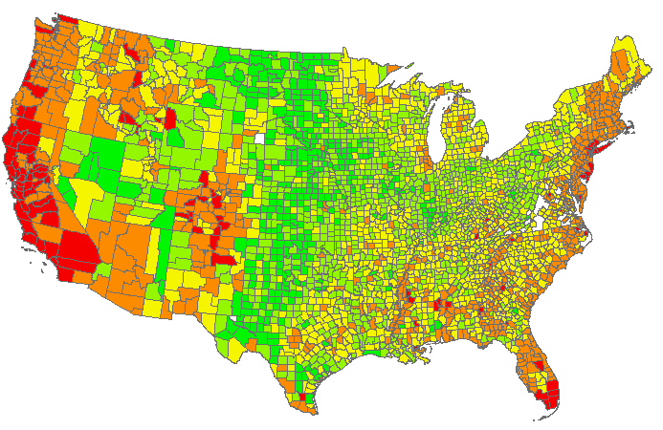

Housing Stress: Fiscal
Stress Index

Slide 41
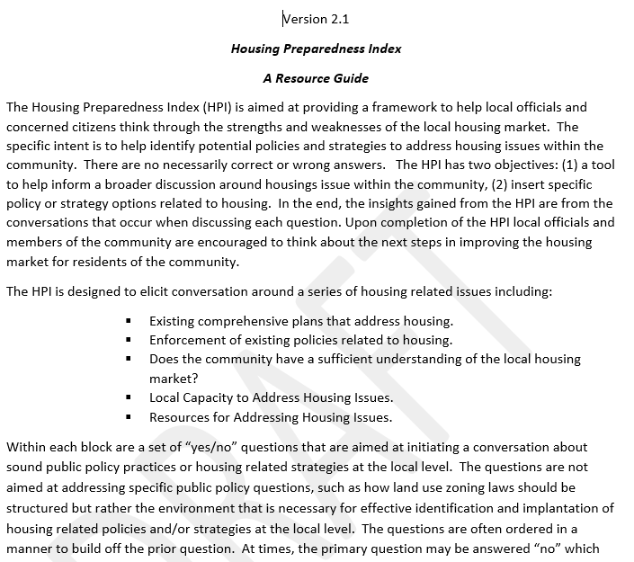
The Wisconsin Housing CEA

Slide 42
The Wisconsin Housing CEA
Sample Questions
YES | NO | Not Sure | Existing Plans/Policies Related to Housing
O | O | O | We have a comprehensive plan in place that identifies our vision of our community.
O | O | O | Our comprehensive plan has identified land use patterns related to residential, commercial, industrial, agriculture and mixed uses.
O | O | O | As a community we have revisited and updated our comprehensive in the past five years as the conditions of our community change.
O | O | O | We have developed, implemented and enforced land use regulations that guide the location of future development and protect prized features of our community.

Slide 43
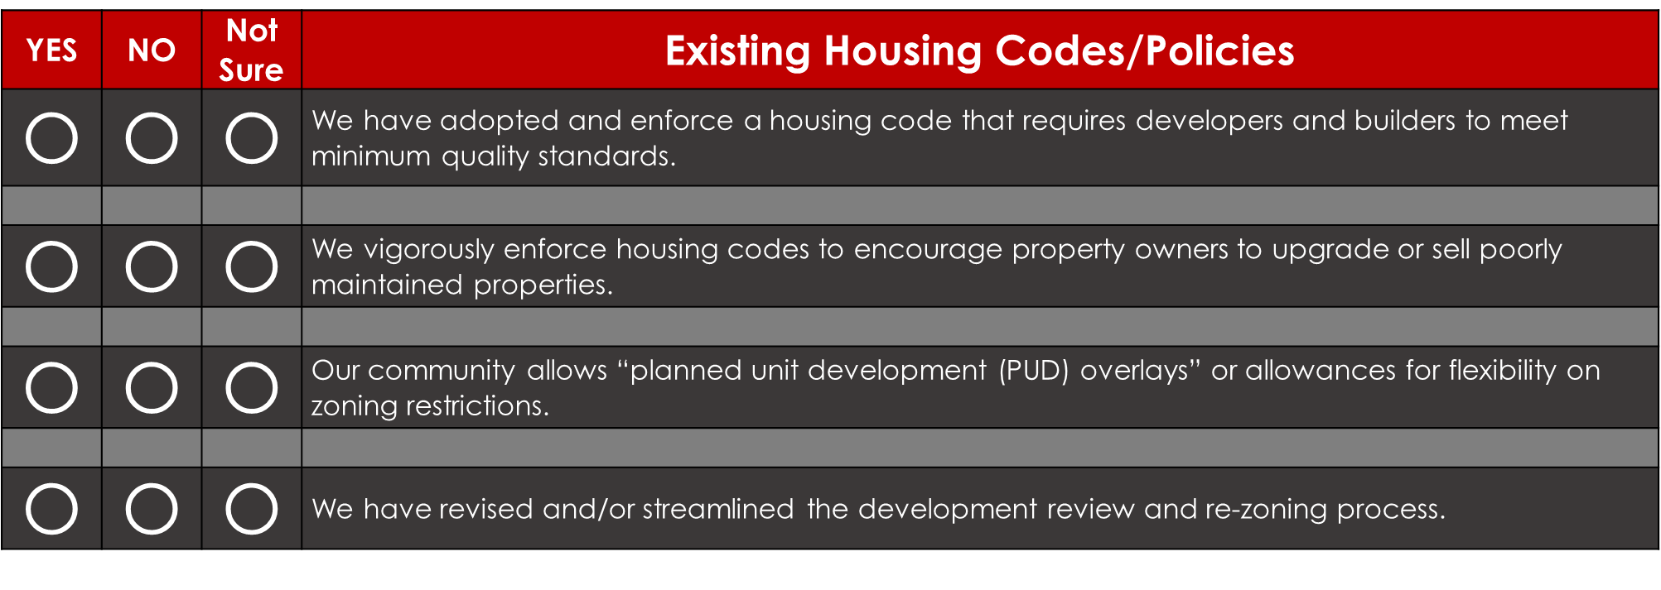
The Wisconsin Housing CEA
Sample Questions

Slide 44
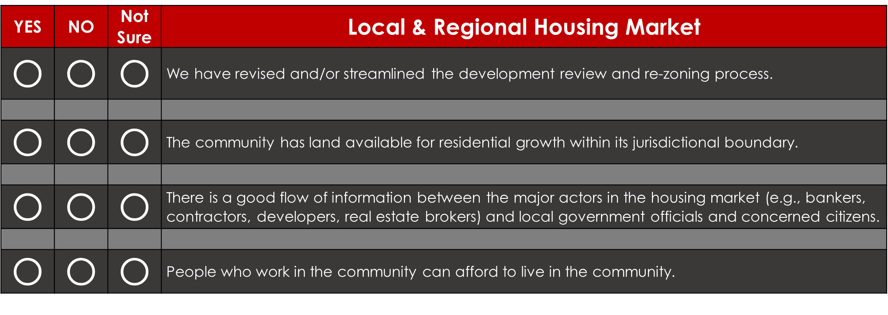
The Wisconsin Housing CEA
Sample Questions

Slide 45
The Wisconsin Housing CEA
Sample Questions

Slide 46
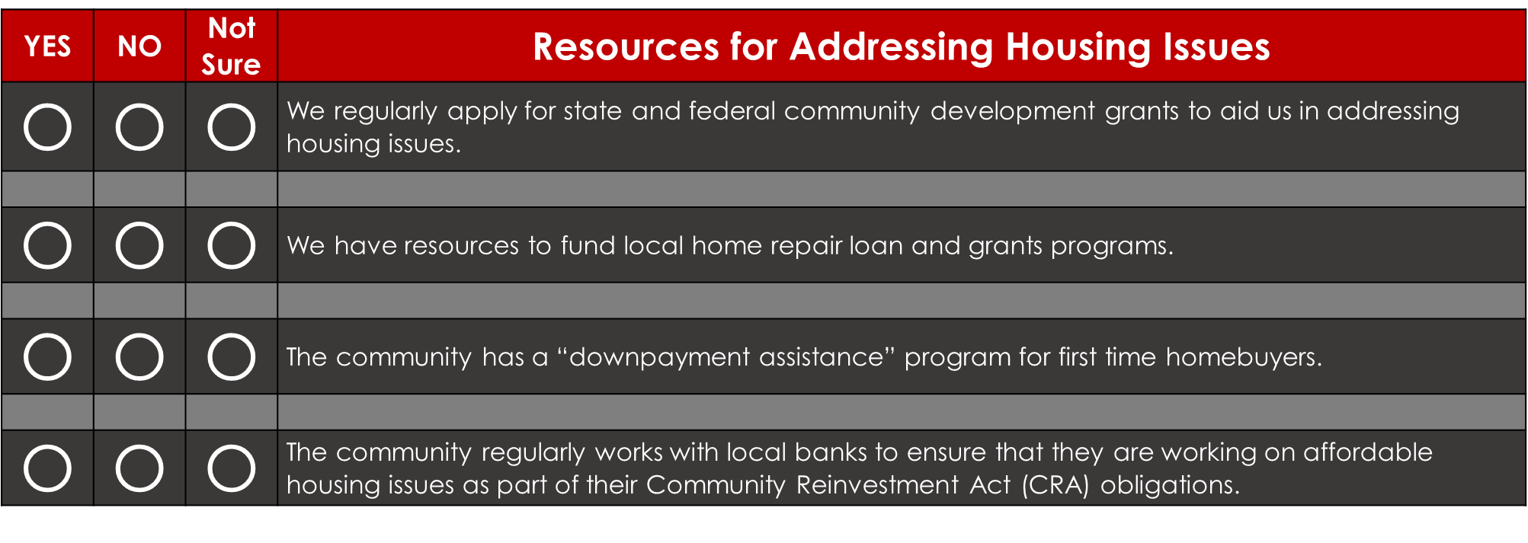
The Wisconsin Housing CEA
Sample Questions

Slide 47
The Wisconsin Housing CEA
Take Action
Facilitate process to identify 3-5 actionable items
  Revisit existing building codes and enforcement policies, gather additional information, etc.
Develop action/implementation plans
  Match local capacity with identified needs

Slide 48
The Wisconsin Housing CEA
Follow-up, follow-up, follow-up!!!
Next Steps
A program that builds off the Housing Snapshot and the HCEA to identify opportunities to address local housing issues.
Customized to meet local needs.
Designed by local UW-Extension Educator with support from UW-Extension Specialists and Educators.

Slide 49
The Wisconsin Housing CEA Program
Steven Deller
Todd Johnson
Karina Ward

