Slide 1
Housing Market Needs in Wisconsin: What Do They Look Like?
Kirk McClure
University of Kansas
May 16, 2022

Slide 2
How do we assess the health of a housing market?
Market Conditions: Supply is adequate to meet the demands of the population
Vacancy rates maintain balance between supply and demand
Growth of supply matches growth of population
Market Needs: Price profile matches income distribution of the population
Ample units in each price range to permit affordability
___________________________________________________________________________________________
Housing Market Needs in Wisconsin: What Do They Look Like? UW – Madison Extension 2022 Housing Symposium
Kirk McClure, University of Kansas May 16, 2022

Slide 3
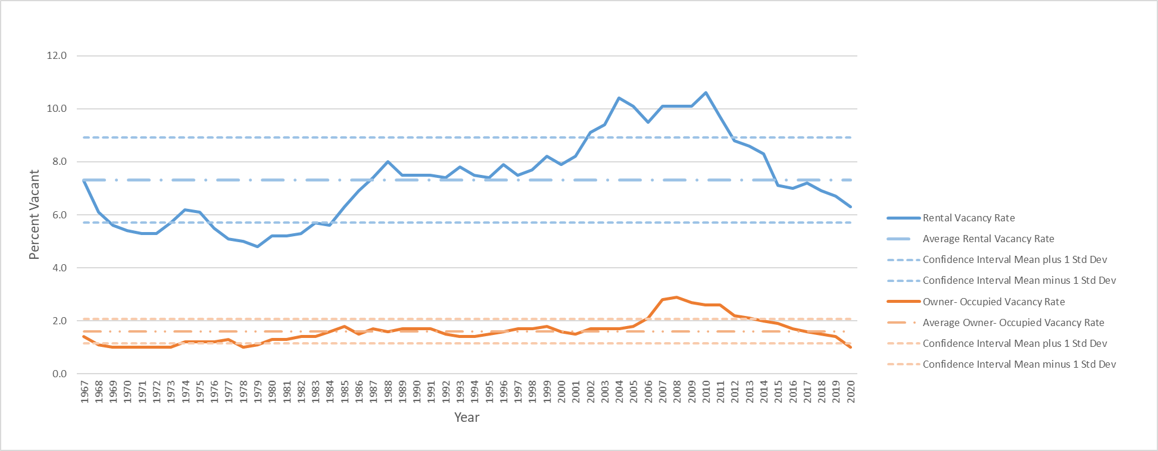
Vacancy Rates in US Metropolitan Areas by Tenure 1967 to 2020
___________________________________________________________________________________________
Housing Market Needs in Wisconsin: What Do They Look Like? UW – Madison Extension 2022 Housing Symposium
Kirk McClure, University of Kansas May 16, 2022

Slide 4
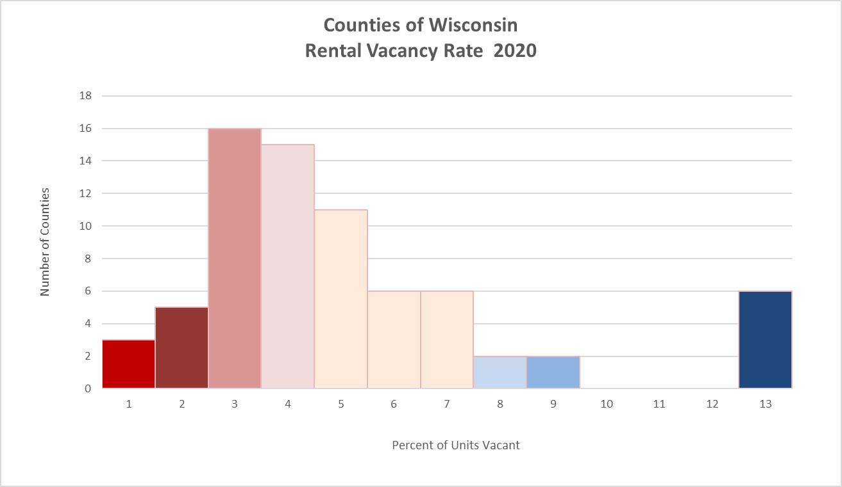
Rental Vacancy Rates in Wisconsin Counties 2020
___________________________________________________________________________________________
Housing Market Needs in Wisconsin: What Do They Look Like? UW – Madison Extension 2022 Housing Symposium
Kirk McClure, University of Kansas May 16, 2022

Slide 5
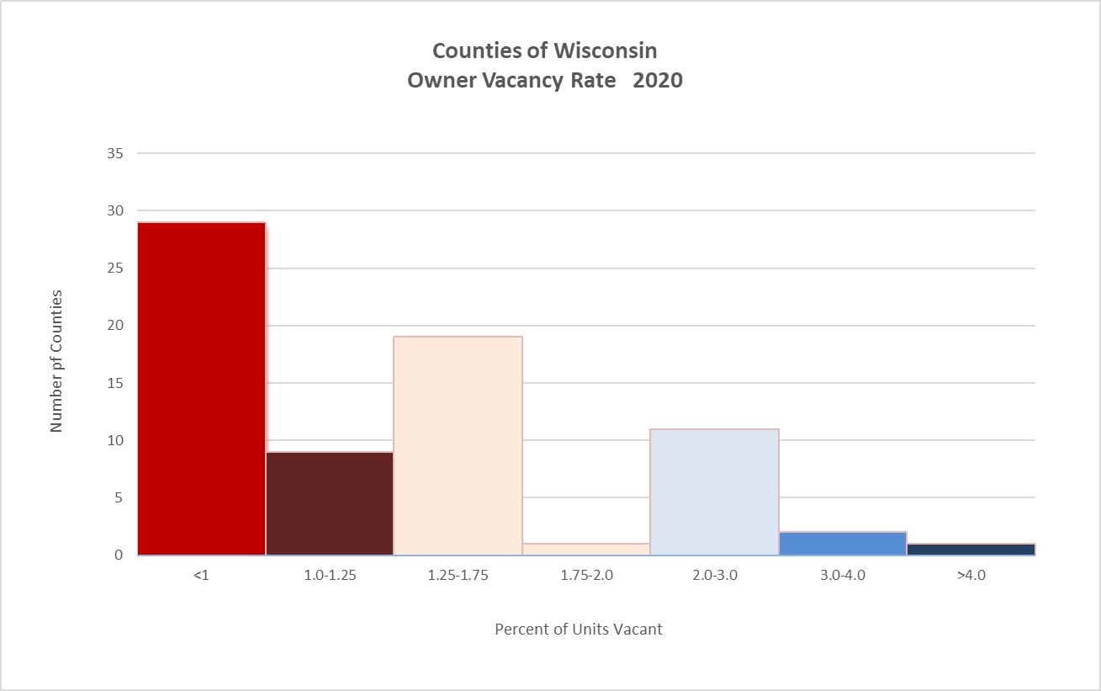
Owner-Occupied Vacancy Rates in Wisconsin Counties 2020
___________________________________________________________________________________________
Housing Market Needs in Wisconsin: What Do They Look Like? UW – Madison Extension 2022 Housing Symposium
Kirk McClure, University of Kansas May 16, 2022

Slide 6
Wisconsin Growth of Population and Housing 1990 to 2020
___________________________________________________________________________________________
Housing Market Needs in Wisconsin: What Do They Look Like? UW – Madison Extension 2022 Housing Symposium
Kirk McClure, University of Kansas May 16, 2022

Slide 7
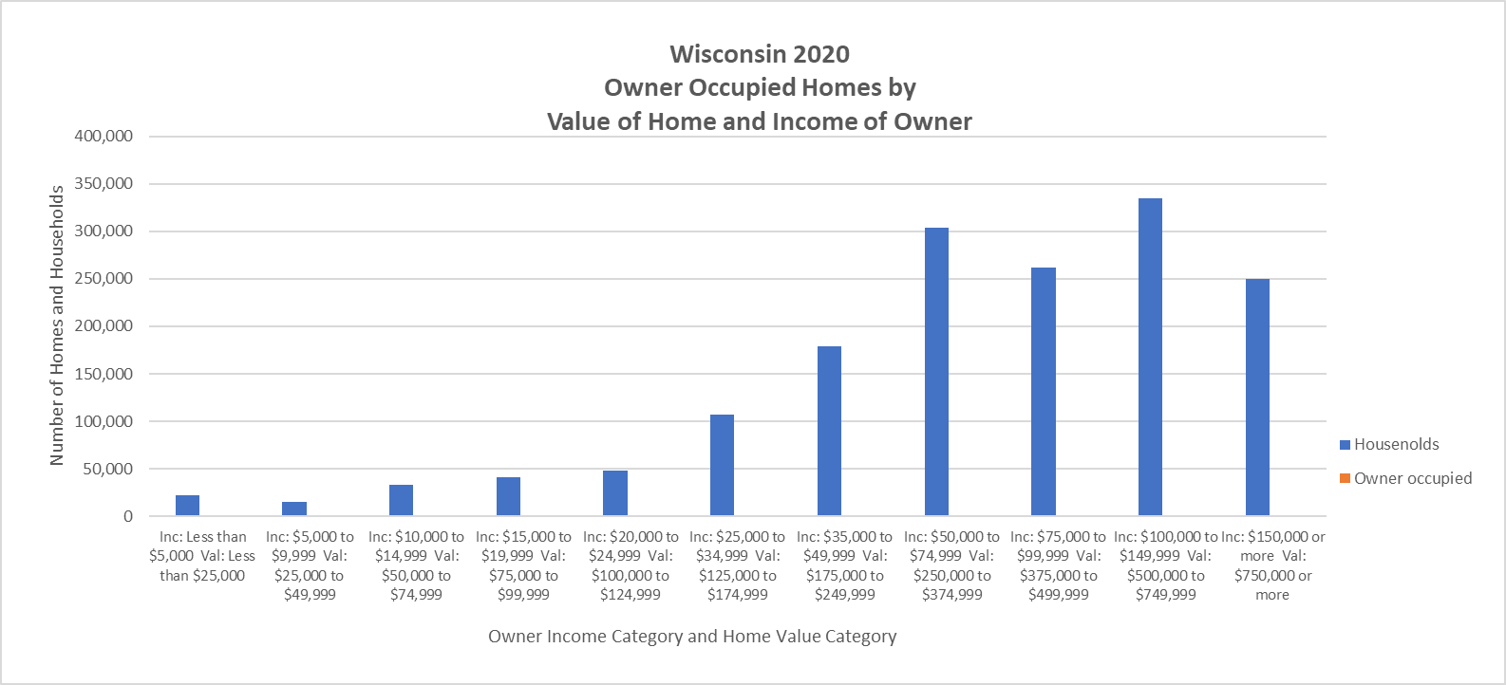
Wisconsin Matchup Homeowner Income and Home Value 2020
___________________________________________________________________________________________
Housing Market Needs in Wisconsin: What Do They Look Like? UW – Madison Extension 2022 Housing Symposium
Kirk McClure, University of Kansas May 16, 2022

Slide 8
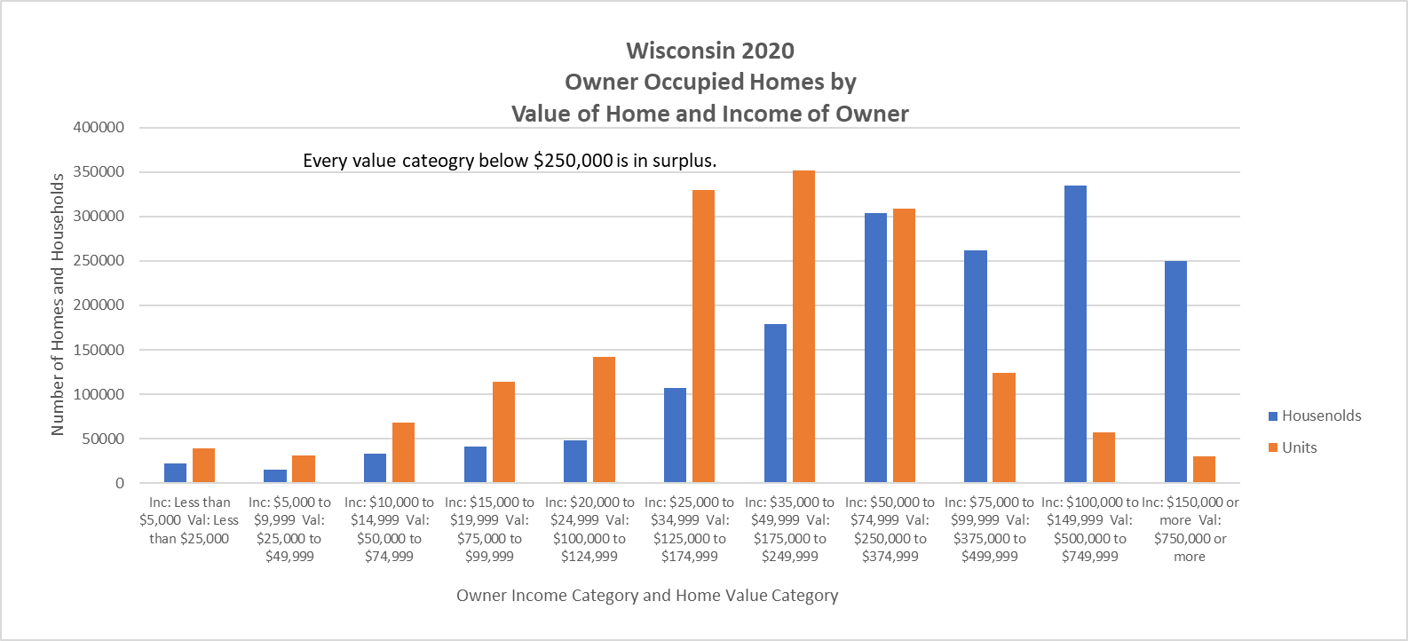
Wisconsin Matchup Homeowner Income and Home Value 2020
___________________________________________________________________________________________
Housing Market Needs in Wisconsin: What Do They Look Like? UW – Madison Extension 2022 Housing Symposium
Kirk McClure, University of Kansas May 16, 2022

Slide 9
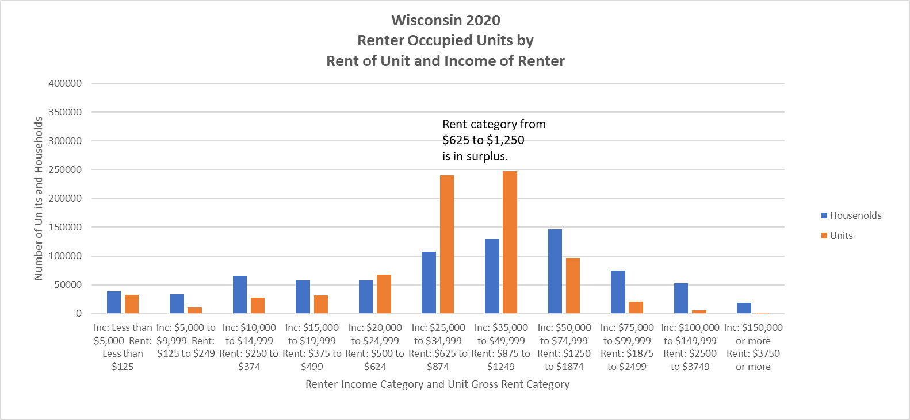
Wisconsin Matchup Renter Income and Gross Rent 2020
Every category below $500
has a shortage.
___________________________________________________________________________________________
Housing Market Needs in Wisconsin: What Do They Look Like? UW – Madison Extension 2022 Housing Symposium
Kirk McClure, University of Kansas May 16, 2022

Slide 10
Wisconsin Housing Market Conditions and Needs 2020
Conditions of Housing Markets
Vacancy rates are low but the problem is transitory
Production has exceeded needs
Needs with Housing Markets
Enviable affordability in most markets
Need is acute among poor renters
Vouchers the best answer
___________________________________________________________________________________________
Housing Market Needs in Wisconsin: What Do They Look Like? UW – Madison Extension 2022 Housing Symposium
Kirk McClure, University of Kansas May 16, 2022

