Slide 1


Rural Pharmacies: An Overlooked Piece of the Rural Health Care System
Melissa Kono
Community Development Institute
University of Wisconsin-Madison
Steven Deller
Department of Agricultural and Applied Economics
EDA University Center
Community Development Institute
University of Wisconsin-Madison
University of Wisconsin-Madison
EDA University Center Lunch ‘n Learn
Tuesday, February 20, 2024, 12 – 1pm

Slide 2



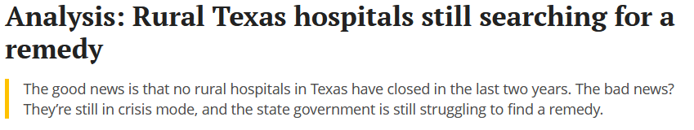
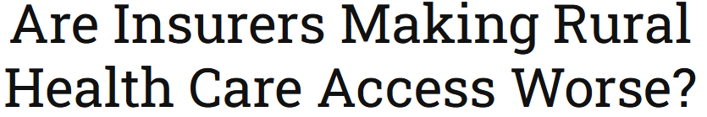

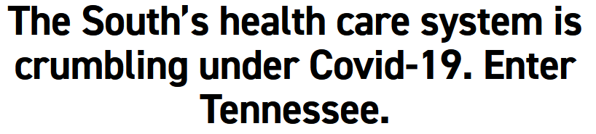




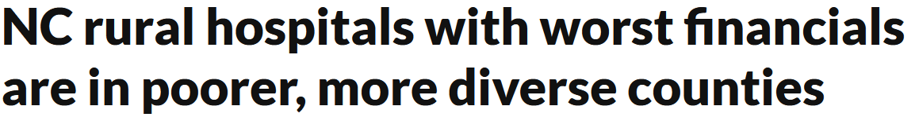


Slide 3
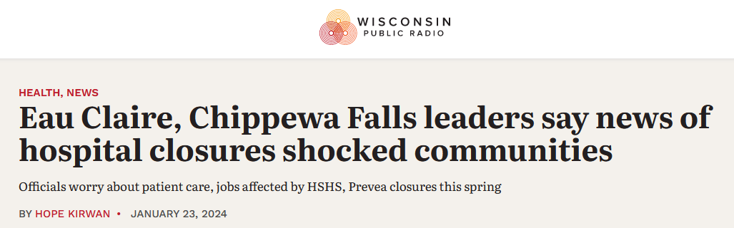

Slide 4
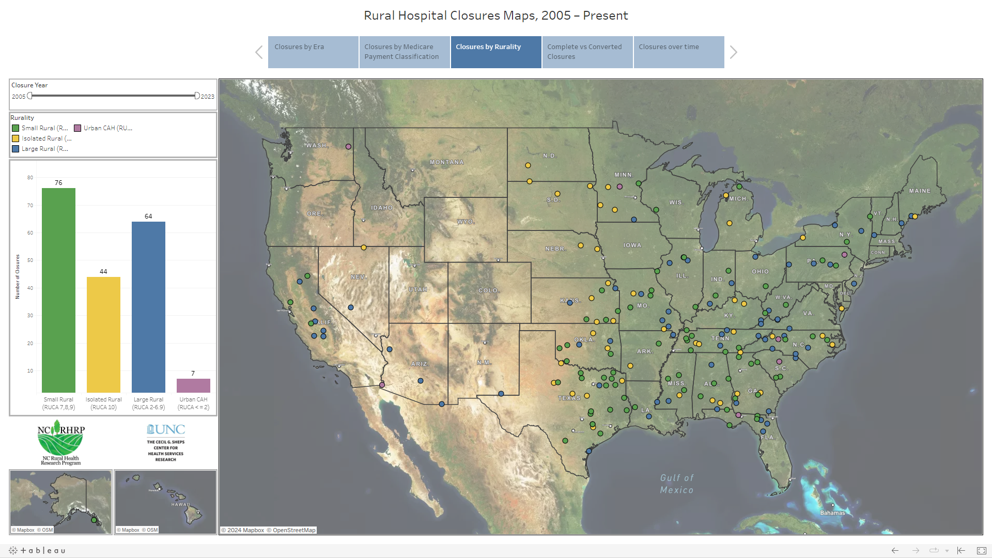

Slide 5


Health Outcomes and Location
Are health outcomes and behaviors different across urban-rural?
Is access to health care different across urban-rural?
Access to pharmacies: An often-overlooked dimension of health care.

Slide 6
Health Outcomes Across the Urban-Rural Spectrum
All differences are statistically significant at or above 95.0%.

Slide 7
Health Outcomes Across the Urban-Rural Spectrum
All differences are statistically significant at or above 95.0%.

Slide 8
Health Outcomes Across the Urban-Rural Spectrum
Generally, health outcomes are less desirable in rural areas relative to urban, but the patterns across nonmetro adjacent and nonmetro remote are less consistent. For some indicators, remote rural is the healthiest of the three groupings.

Slide 9
Access to Health Across the Urban-Rural Spectrum
All differences are statistically significant at or above 95.0%.

Slide 10
Access to Health Across the Urban-Rural Spectrum
All differences are statistically significant at or above 95.0%.

Slide 11
Access to Health Across the Urban-Rural Spectrum
All differences are statistically significant at or above 95.0%.

Slide 12
Health Outcomes Across the Urban-Rural Spectrum
Generally, access to health care is less desirable in rural areas relative to urban, but the patterns across nonmetro adjacent and nonmetro remote are less consistent.
Are nonmetro adjacent counties simply accessing health care in nearby metro counties? If “yes” how do we define access from a geographic perspective?

Slide 13
For many parts of rural America access to health care is in crisis.
Much of the public discussion tends to focus on rural hospital closures.
Hospitals is but one part of the health care delivery systems.
Pharmacies are in integral part of the delivery system but is largely overlooked.
In this study we seek to:
Analyze patterns of pharmacies across the U.S.
Is there a distinction between rural and urban communities?
Is there a distinction between independent and chain pharmacies?
Does the growth in chain pharmacies “push out” independent pharmacies?

Slide 14
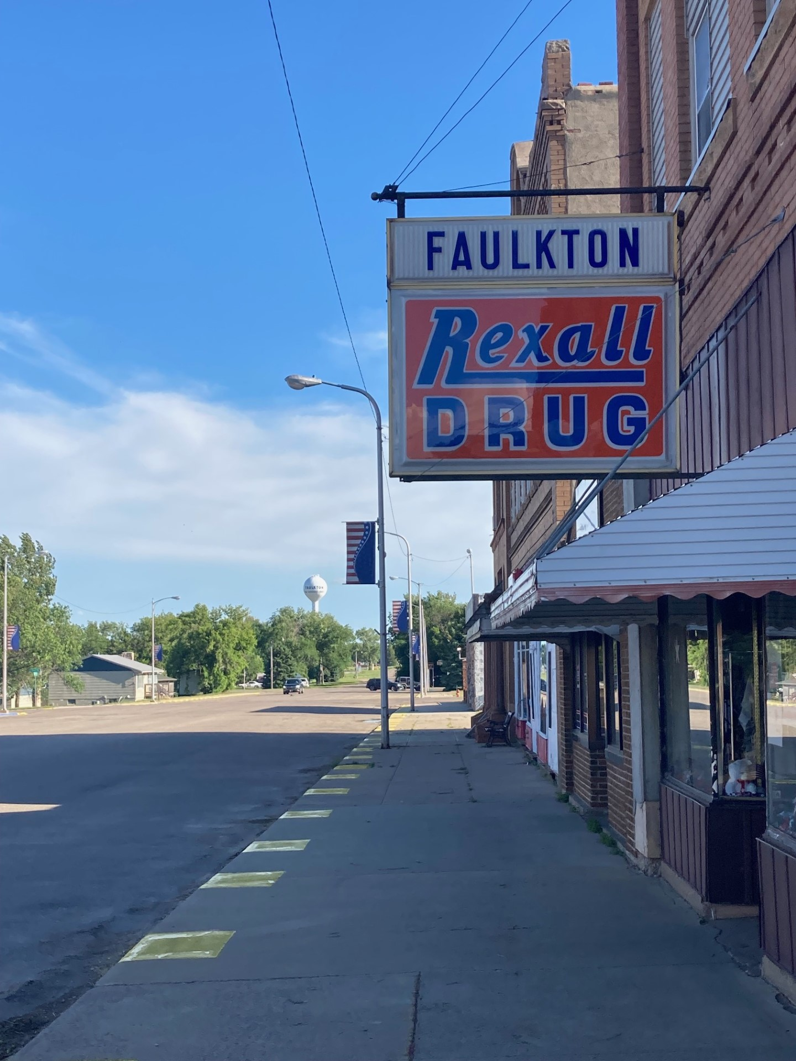
Types of Pharmacies
Community Pharmacies are the most common type of pharmacy but some health care facilities like hospitals, clinics, nursing homes also have pharmacies on the premises.
Other types of pharmacies such as research, regulatory, and compounding deal with the research and production of medications and do not provide services directly to customers.
We delineate amongst community pharmacies to “independent pharmacies” such as those owned by an individual, group, or cooperative of pharmacists, and “chain” pharmacies like Walgreens, CVS, Wal-Mart, etc.
Notes:
https://www.news-medical.net/health/Types-of-Pharmacy.aspx

Slide 15
Policy changes lead to pharmacy closures
The implementation of Medicare Part D in 2006 expanded prescription coverage to Medicare recipients but came with low reimbursement rates for pharmacies, particularly independent community pharmacies who relied on sales of prescriptions by patients paying cash more than retail chain pharmacies.
Left many rural residents without access to a pharmacy— “pharmacy deserts”
Changes to reimbursement rates for Medicare Part D prescriptions, as well as allowing reimbursement for patient counseling
Notes:
(Pharmacists are not currently recognized as health care providers under Medicare) can make it more cost effective to operate a pharmacy.

Slide 16
Pharmacies as health care
Pharmacists not only ensure that medications are safe but also provide patient counseling.
Pharmacists are more accessible to patients for information and care (and much more cost effective).
Pharmacies provide preventative health services such as immunizations, blood pressure checks and glucose monitoring.
Providing these routine services can help prevent patients from needing more costly care such as hospital stays. Particularly in rural areas, where patients have less access to health care services, pharmacies play a vital role in the delivery of health care.
Notes:
Patients more likely to talk to their Pharmacist

Slide 17
Pharmacies as health care
Without these services rural consumers delay or forego essential treatment with prescription medications thus exacerbating underlying health problems.
In rural areas, pharmacies may be the only source of qualified health care services, especially as rural hospitals close or consolidate.
High degree of trust with a pharmacist.
Notes:
Patients more likely to talk to their Pharmacist

Slide 18
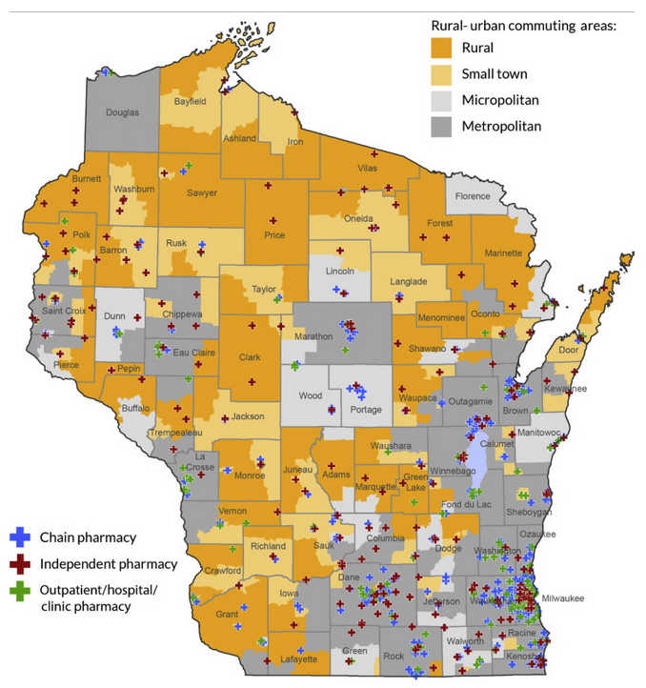

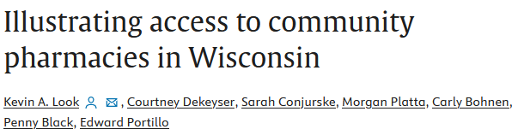
Notes:
Patients more likely to talk to their Pharmacist

Slide 19
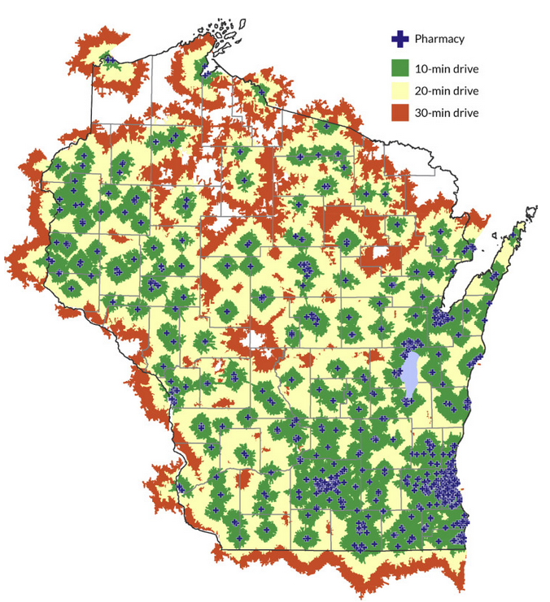
Notes:
Patients more likely to talk to their Pharmacist

Slide 20
A Preliminary Analysis of Rural Pharmacies
Notes:
The pattern of chain pharmacies being more predominate in more urban (metro) areas while independent pharmacies are more predominate in rural areas is evident from the Beale Code bases comparisons (Figure 4). Indeed, the most rural counties have no chain pharmacies present at any time over the 2011 to 2020 study period: those that are classified as completely rural or less than 2,500 urban population but are adjacent to a metro area, 99 out of 219 counties (45.2%) and for those that are classified as completely rural or less than 2,500 urban population and not adjacent to a metro area 240 out of 414 counties (58.0%) have no chain pharmacies. These same rural counties are much more dependent on independent pharmacies. Those completely rural but adjacent only 15.5% and 22.0% of the completely rural and non-adjacent have no independent pharmacies. Of the 633 counties that are classified in these “most rural” (Beale Code groups 8 and 9) 95 (15.0%) have no pharmacies of either type over the study period. This is largely consistent with the findings of Qato and her coauthors (2017).

Slide 21
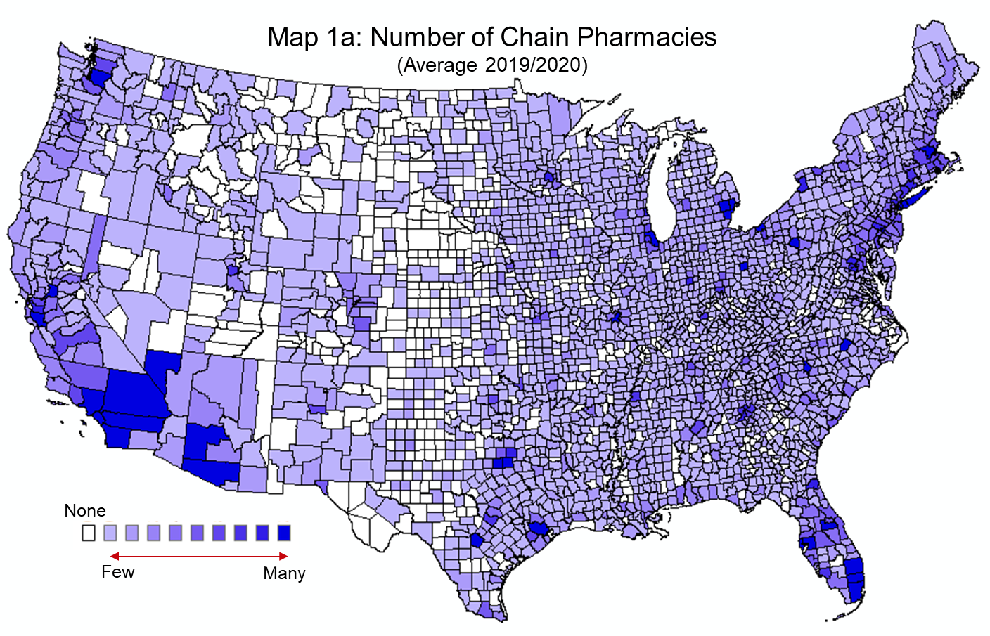
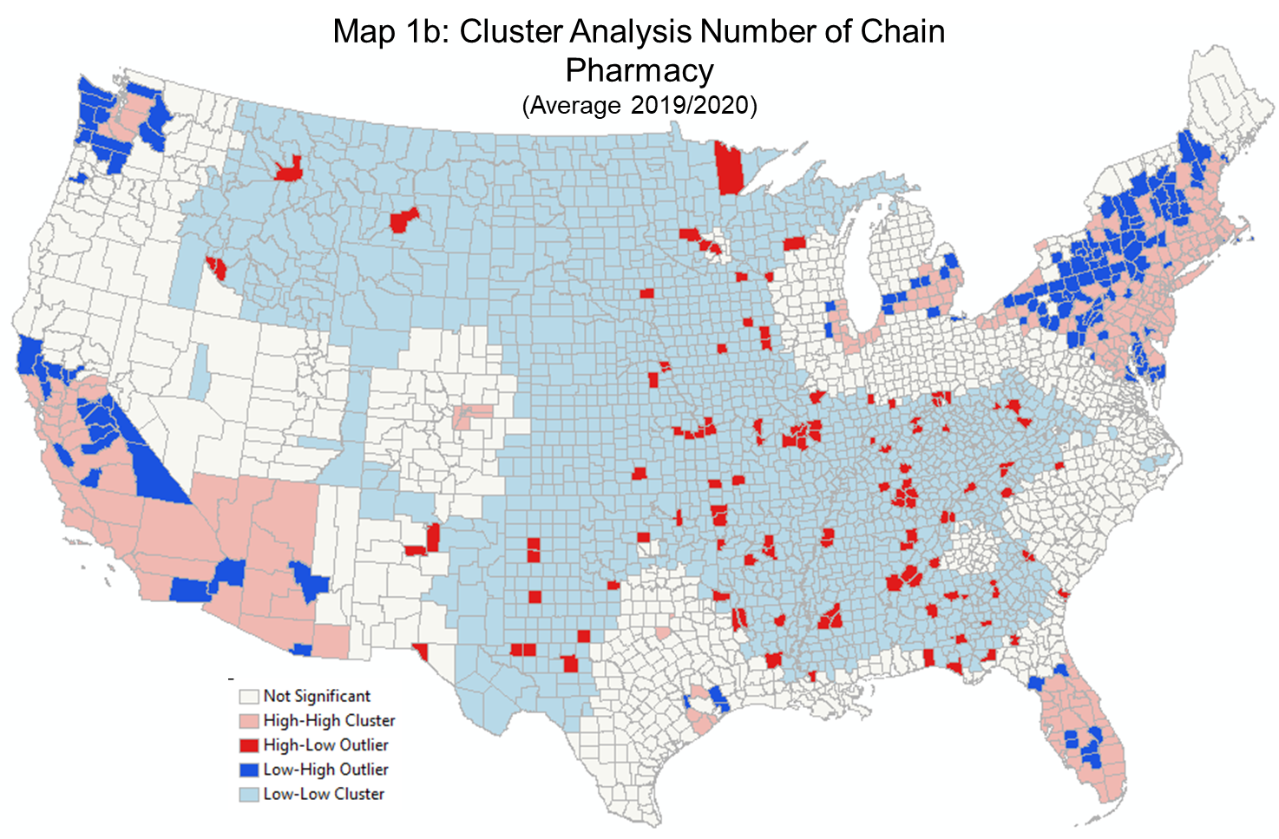
Notes:
A mapping of the annual average number of chain pharmacies, again adjusted for population, reveals that counties without chain pharmacies are largely scattered across the U.S. but is most likely to be located in the Great Plains, particular from North Dakota south to western Texas (Map 1). From simple firm location theory (see Shaffer, Deller and Macrouiller 2004) it is likely that there is simply not a sufficient population base in many of these more rural counties to support a pharmacy, particularly a chain pharmacy.

Slide 22
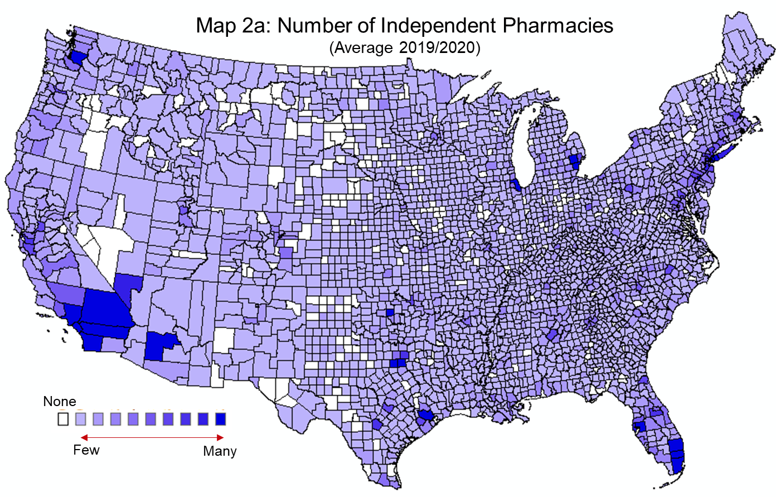
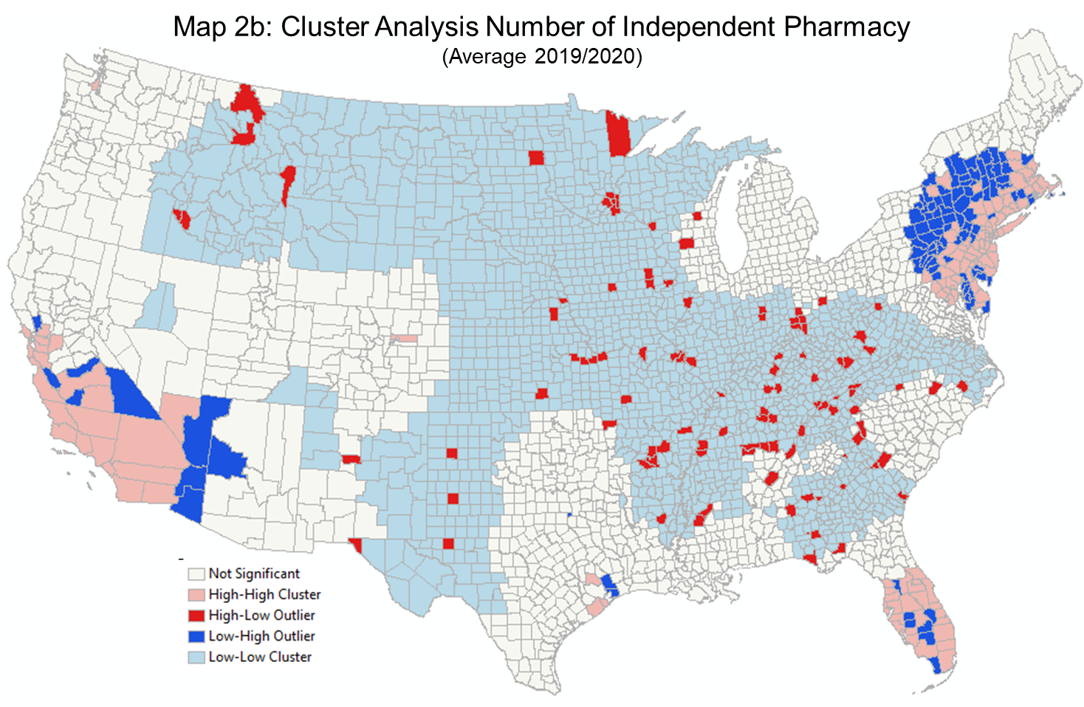
Notes:
But a comparable mapping of independent pharmacies suggest that these rural counties in the Great Plains that are “chain pharmacy deserts” have relatively high concentrations of independent pharmacies (Map 2). While one must keep in mind that these are population adjusted concentrations, it is clear that rural communities are particularly dependent on independent pharmacies.

Slide 23
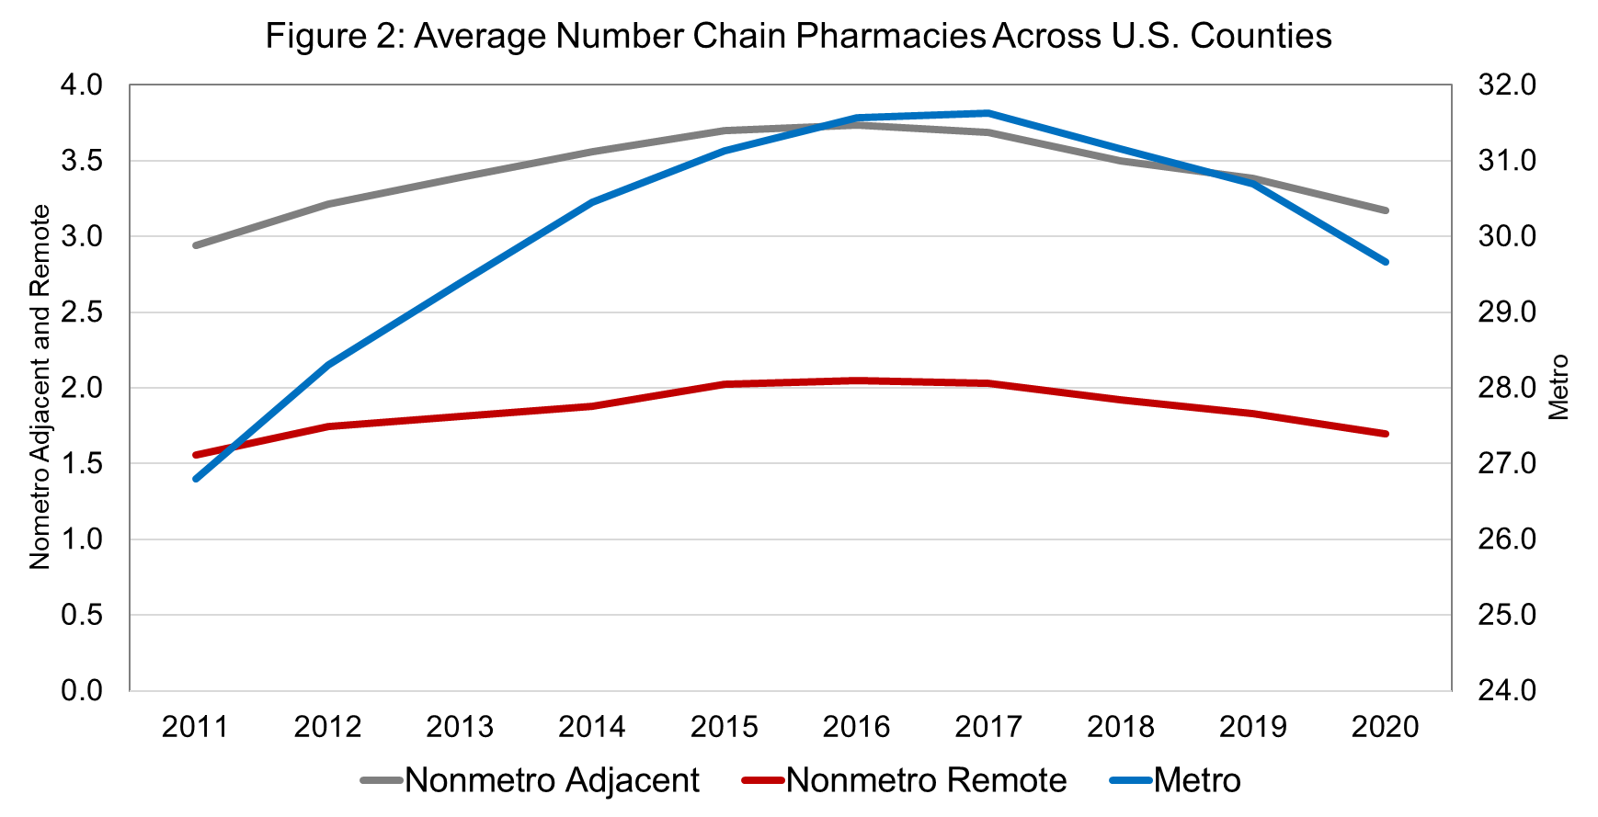
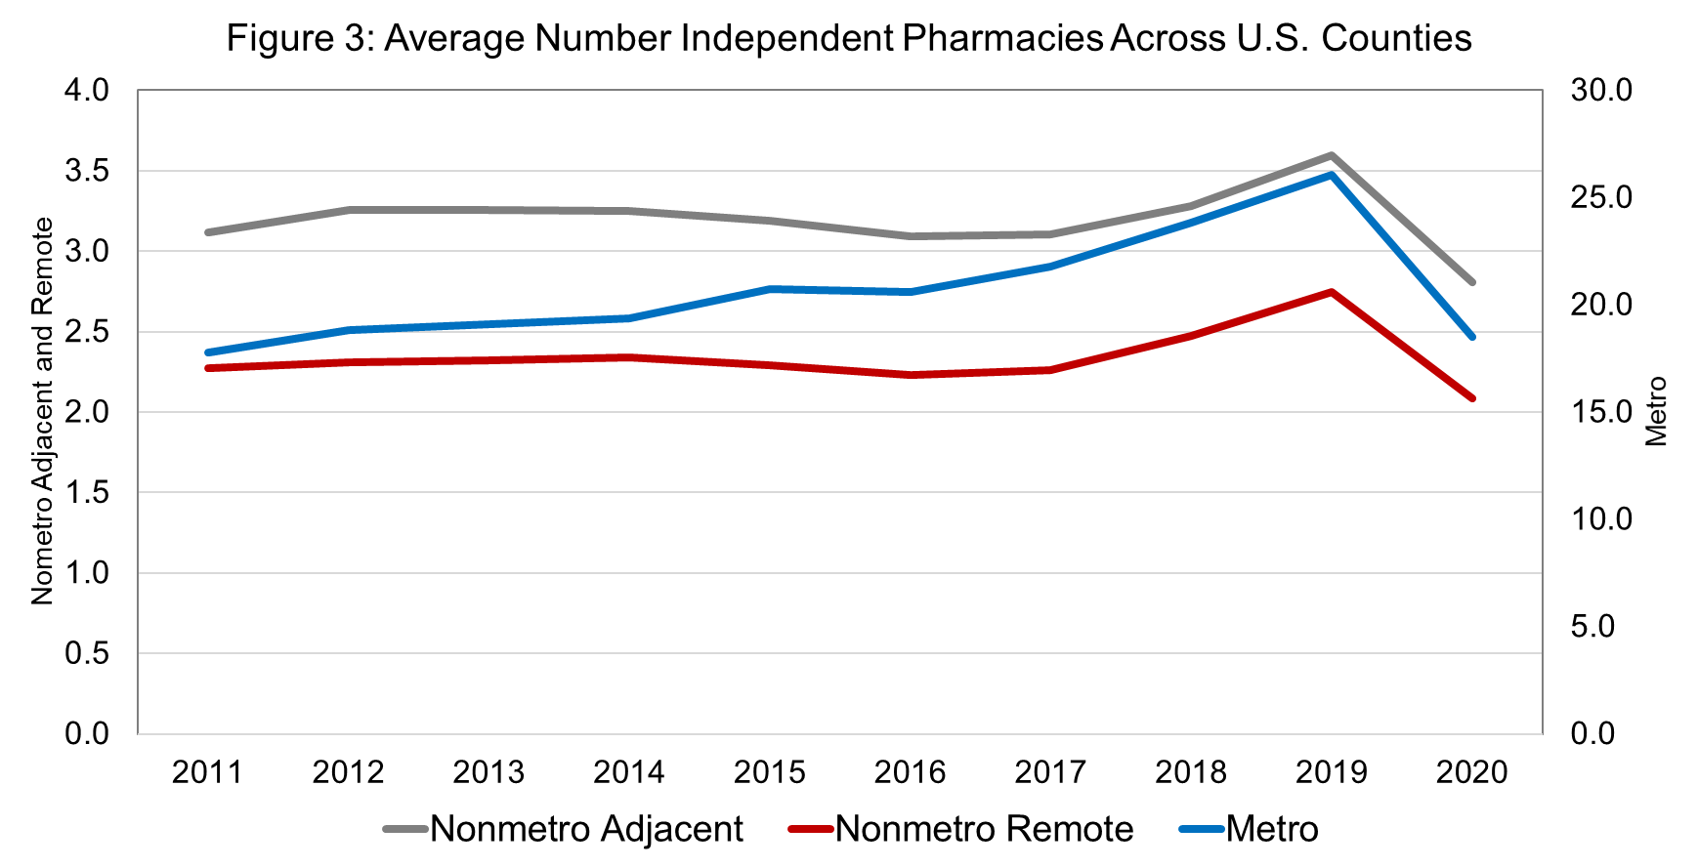
Notes:
As noted above, the concentration of chain pharmacies is higher in metropolitan countries with the lowest concentration in nonmetropolitan remote counties (Figure 2). The growth in the concentration of chain pharmacies trend upward across all three types of counties until 2017 when there is a noticeable decline. This reflects the consolidation of even chain pharmacies into fewer and larger stores. Perhaps more important, it is in this period that on-line pharmacy services became more prevalent. Indeed, there is a movement amongst many health insurers to require patients to use specific online services to have long-term prescriptions filled. Further, while established drug chains like CVS and Walgreens have long offered mail delivery services for prescriptions, some big names like Amazon have
The pattern for the concentration of independent pharmacies across the three-part rural-urban spectrum is much more stable than chain pharmacies (Figure 3). Here independent pharmacies, once population is accounted for, tend to be more likely to be present in remote rural areas and less likely to be in metropolitan areas. Also, the decline in chain pharmacies stores driven by the advent of on-line pharmacies, is not evident with independent pharmacies. Indeed, there is mild evidence of an increase in the concentration of independent pharmacies post 2017. This latter trend is particularly evident in rural remote counties. The impact of COVID on the concentration of independent pharmacies is clear for

Slide 24
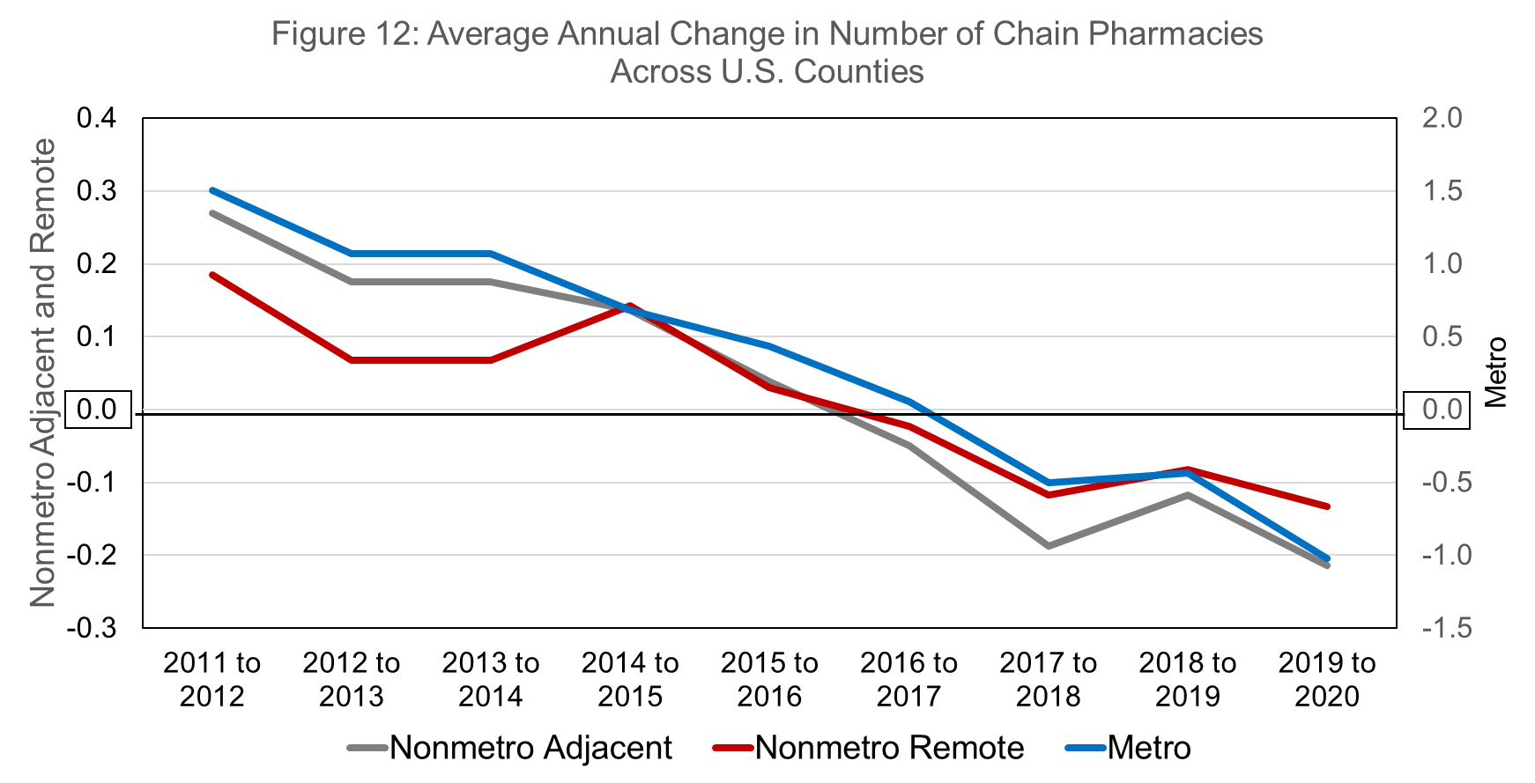
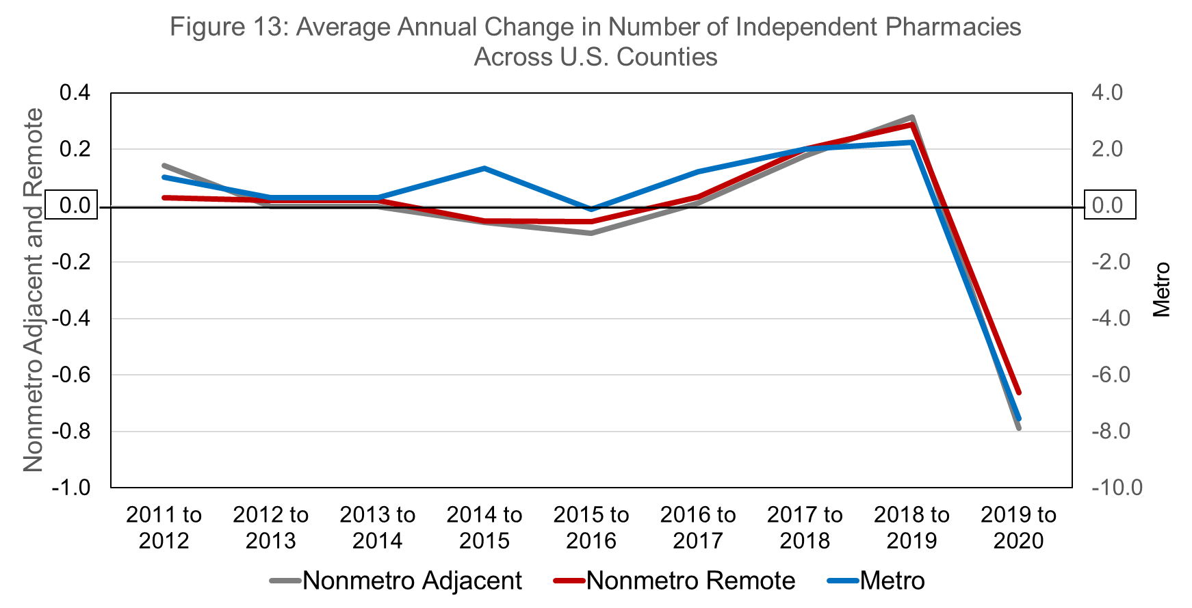

Slide 25
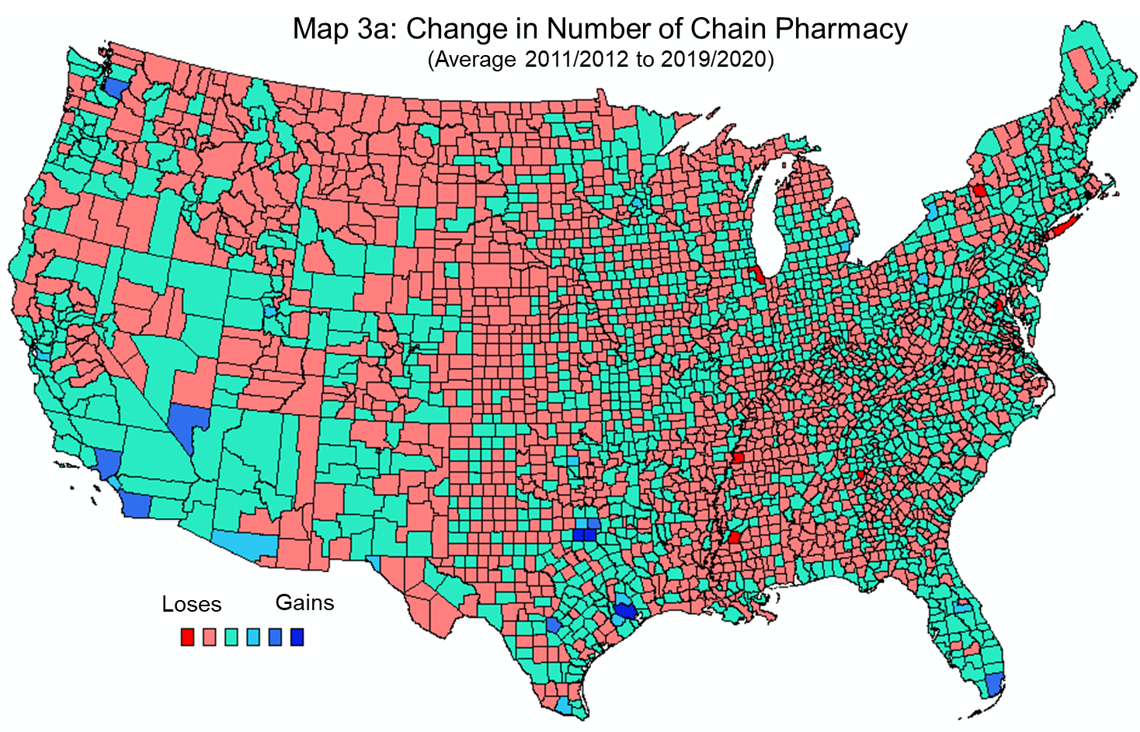
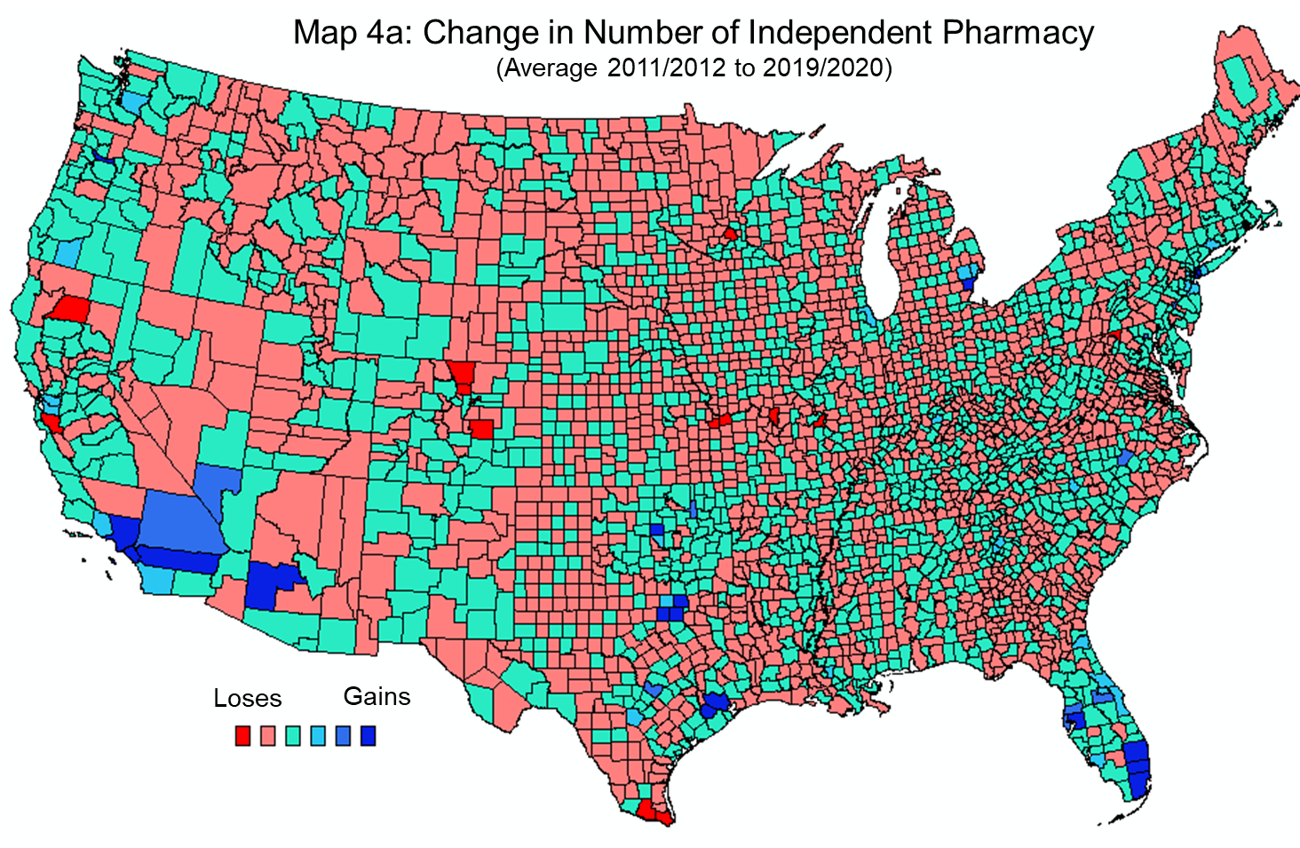

Slide 26
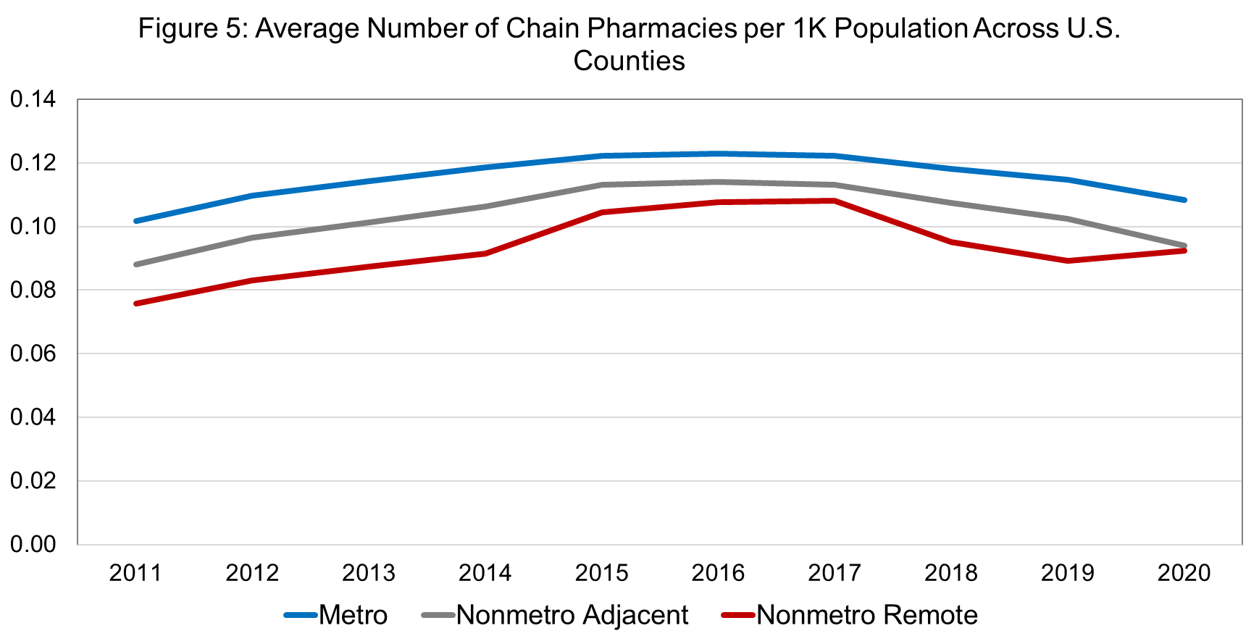
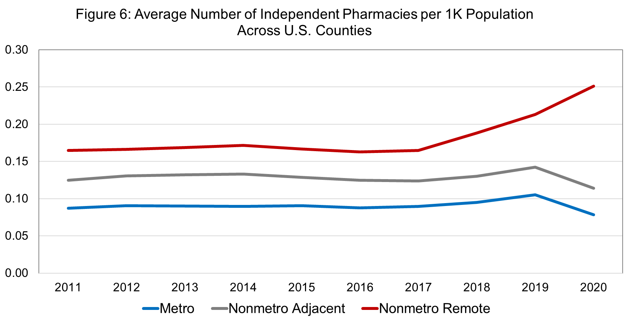

Slide 27
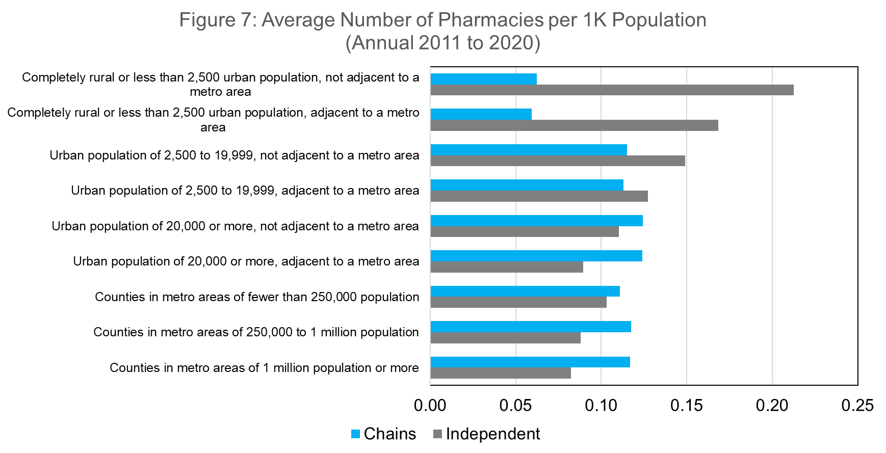

Slide 28
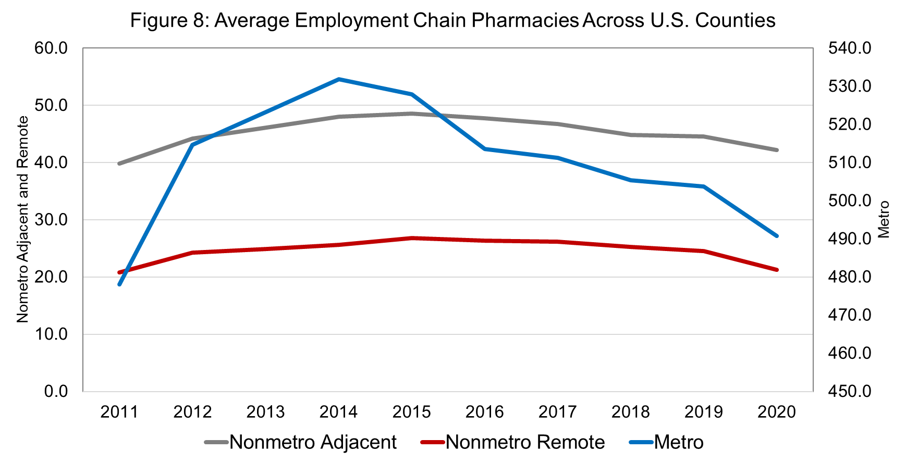
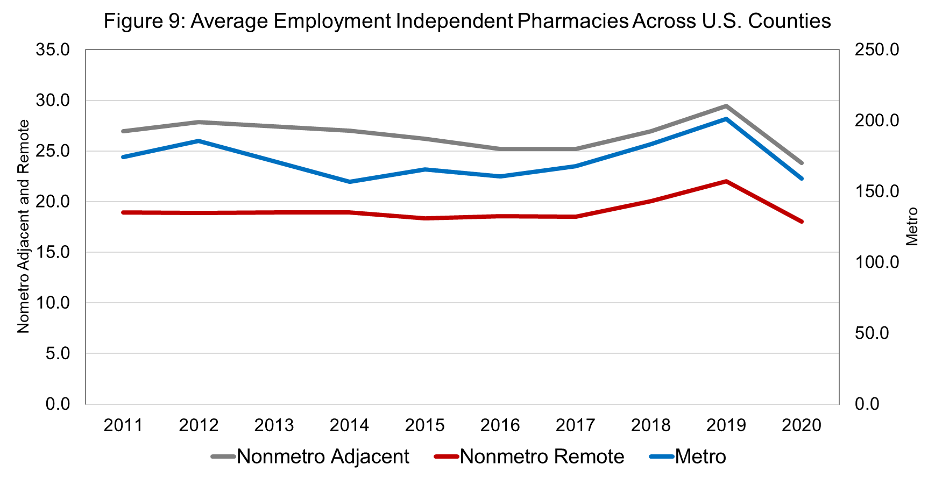
Notes:
One thing to point out when it comes to employment in pharmacies, is that Chains are more likely (and able) to employ multiple pharmacists whereas independent, sole proprieters are the only pharmacist on duty. They often work long hours and without a break. If you think about the amount of schooling they need (on par with medical doctors) but without support.

Slide 29
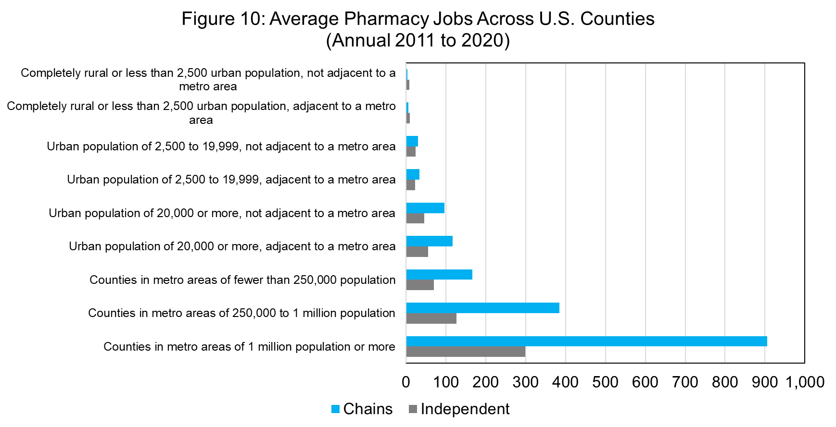

Slide 30
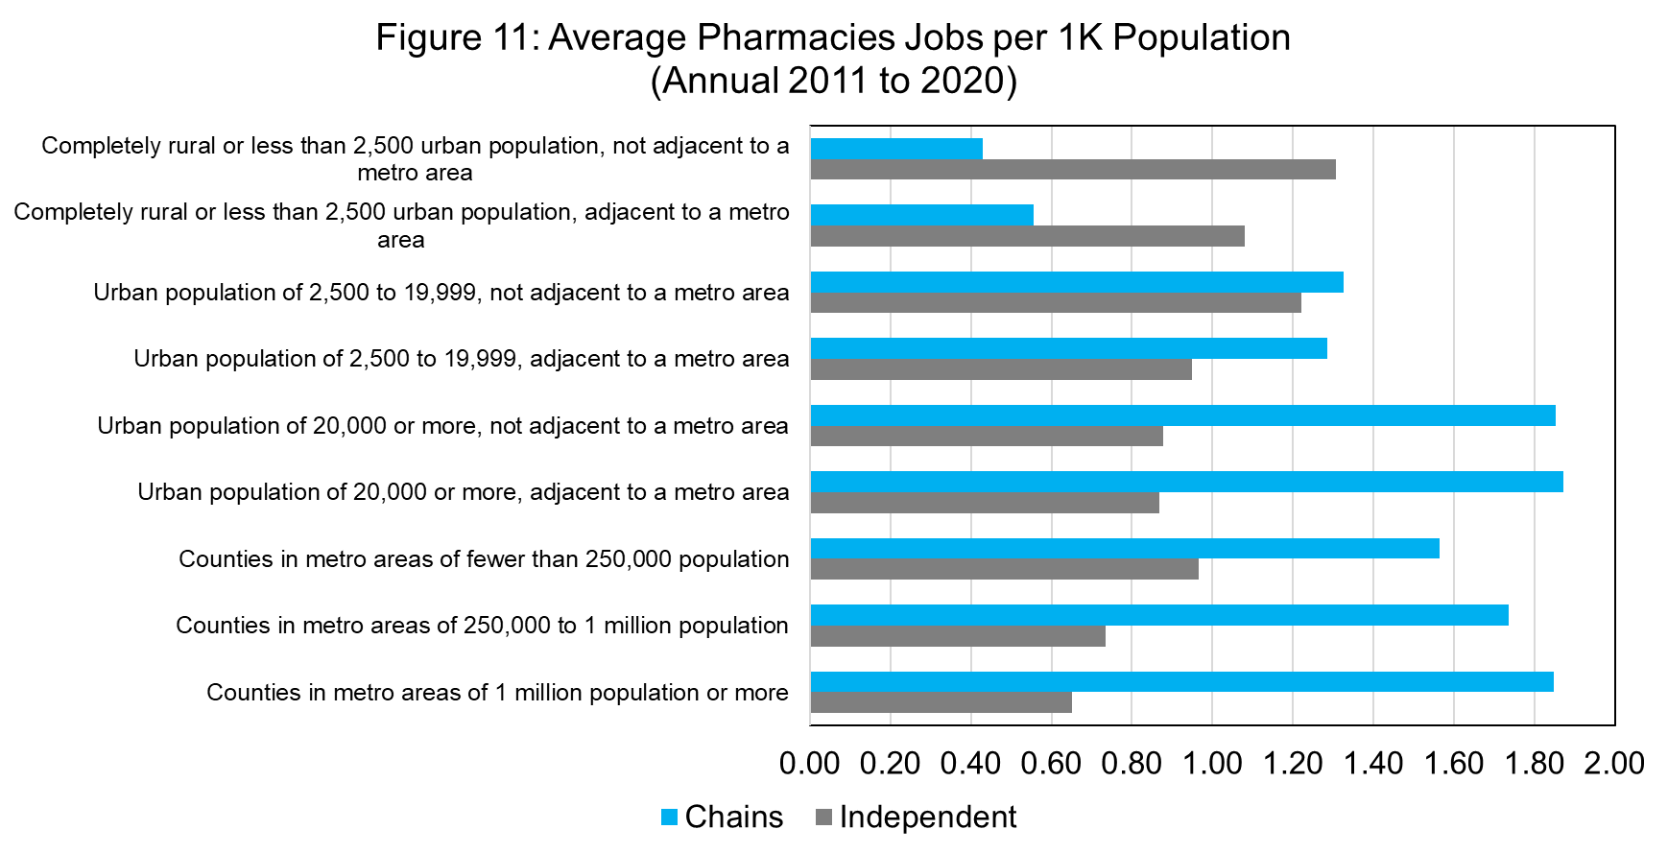
Notes:
No surprise to see that Chain pharmacies are able to employ more workers than independent, or that there are more pharmacy jobs in metro areas. But when we think about the teritiary and preventative services that pharmacists provide, and the role they play in health outcomes, it’s striking to see this difference.

Slide 31



Do chain pharmacies “push out” independent pharmacies?
Modeling the presence of pharmacies:
${PH}_{it}=f({SE}_{it,j},{DM}_{it,k},θ_{t}$) , $θ_{t}$=time fixed effect
$${PH}_{it}$$
Number of Independent Pharmacies
Number of Independent Pharmacies per 1,000 Persons
$${SE}_{it,j},{DM}_{it,k}$$

Slide 32
We have two econometric issues here:
The dependent variable is truncated and “spikey” on zero.
There is clear spatial dependency within the data.

Slide 33


$${PH}_{it}$$
Number of Independent Pharmacies
Number of Independent Pharmacies per 1,000 Persons
Use of number of pharmacies per 1,000 persons helps a bit with the distribution of the dependent variable a little bit, but still have a spike on zero.
We want to estimate the model using subsamples across the urban-rural divide, how do we address the spatial dependency issue?
“exogenous interactions model” (SLX):
$$IPh_{t,i}= αCPh_{t,i}+ \sum_{j=1}^{k}{β_{j}}X_{j,t,i}+ \sum_{j=1}^{m}{θ_{j}}WX_{j,t,i}+ τ_{t}+ ε_{t,i}$$

Slide 34

$${PH}_{it}$$
Number of Independent Pharmacies: Zero Inflated Negative Binomial Estimator
Number of Independent Pharmacies per 1,000 Persons: OLS
We estimate the model for four sets or groupings of counties:
All Counties
Metro Counties
Nonmetro Adjacent Counties
Nonmetro Remote Counties

Slide 35
Changing Markets for Pharmacies Across the Rural-Urban Divide
Across the board, a higher concentration of chain pharmacies “pushes out” independent pharmacies.

Slide 36
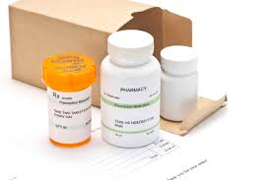
PBMs, Telehealth and Rx by Mail
Pharmacy Benefit Managers (PBMs) act as intermediaries to negotiate rebates and discounts on behalf of health insurers
The explosion of telehealth during the COVID-19 pandemic changed how patients accessed health care, this had led to changes in filling prescriptions
Amazon and Mark Cuban’s Cost Plus Drugs expanded prescription drug delivery
Notes:
PBM (Pharmacy Benefit Managers) were not part of this research but their role in the availability of rx is important. PBMs will direct patients but it might not always the lowest cost or most convenient for the patient.
https://www.commonwealthfund.org/publications/explainer/2019/apr/pharmacy-benefit-managers-and-their-role-drug-spending

Slide 37
But what about prescriptions by mail?
Especially for underserved locations, the option of having prescriptions delivered through the mail may seem like an attractive option when a community pharmacy is unavailable.
The push to increase prescriptions-by-mail services (or on-line services) may be convenient for routine medications, but patients with ailments requiring more immediate relief may not want to wait several days for prescriptions to be delivered.
Not all medications can be delivered safely through the mail
Notes:
Small pharmacies are quick to point out to me that they also offer these services.

Slide 38
Pharmacy graduates and rural areas
Average salaries for pharmacists lag behind in rural areas versus those in urban settings.
The average annual compensation for a pharmacist in a remote rural (nonmetro nonadjacent) county is $126,267 or $10,522 per month.
For the average pharmacy graduate that means nearly 20% of monthly before tax income is going to student debt repayment for those working in rural areas.
For a metro county, where the average salary is $148,8862 annually, or $12,405 per month, the percent of income to student debt drops to 16.3%.
No wonder income rises to the top of employment considerations.
Notes:
Business succession planning, student mentoring, student loan relief programs.
About 10 states have student loan forgiveness programs for pharmacists working in underserved areas.
“If you can’t beat them, join them”

Slide 39
Pharmacy Graduates
Pharmacy students graduate with an average of $179,514 in student debt (American Association of Colleges of Pharmacy)
High levels of student debt are a deterrent to entrepreneurship
Pharmacy students from rural areas are more interested in ownership
Notes:
Legacy students

Slide 40
The future of rural pharmacy
Like many other businesses, pharmacies face challenges such as succession planning and attracting new workers to rural areas
Consolidation with a larger health care system can alleviate overhead costs and administrative burdens
Considerations for expanded student loan forgiveness programs
Key policy changes such as being able to bill for services, restrictions on Pharmacy Benefit Managers, drug costs and reimbursement rates
Notes:
Business succession planning, student mentoring, student loan relief programs.
About 10 states have student loan forgiveness programs for pharmacists working in underserved areas.
“If you can’t beat them, join them”

Slide 41
Questions and Contact Information
Melissa.Kono@wisc.edu
Steven.deller@wisc.edu

